Slide 1
PCB Design Guidelines and Tips

Slide 2
PCB Design Guidelines and Tips
Every project must have a custom PCB
Think carefully about your project and its PCB design and ask the following questions:
What will be the function of my PCB?
Example: acquire data from sensors, control motors and actuators, communicate with a PC or cloud, display information on a screen/LEDs, acquire inputs from keyboard/switches, etc.
Prototype your idea before designing your PCB.
How much time would be required to design, fabricate, solder, test and redesign the PCB?
This course orders PCBs in waves
It takes about 7-10 days to go from PCB wave deadline to delivery
Every PCB should have a processor
Typical projects have microcontrollers (ESP, ATmega, STM, etc).
Raspberry Pi board okay but needs to interface with your custom PCB that also has a microcontroller
FPGA board okay but needs to interface with your custom PCB that also has a microcontroller
Carefully choose PCB components
Size and soldering leads (through hole pins preferred, surface mounts components okay but we careful)

Slide 3
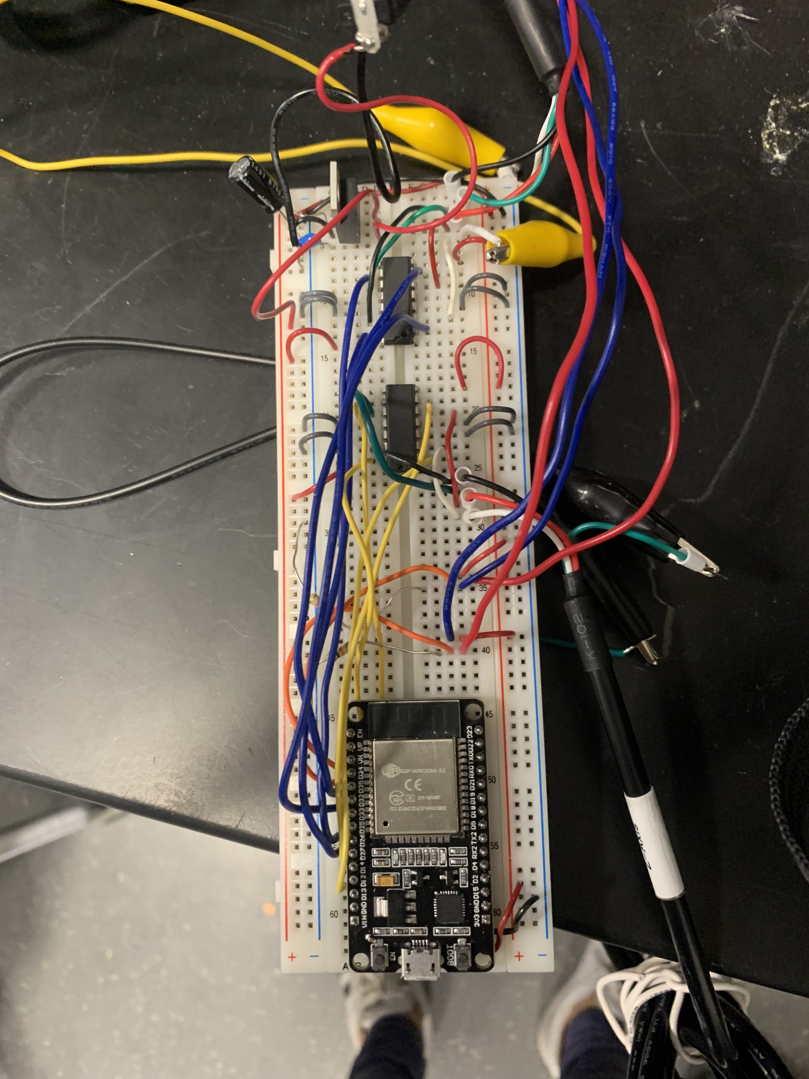
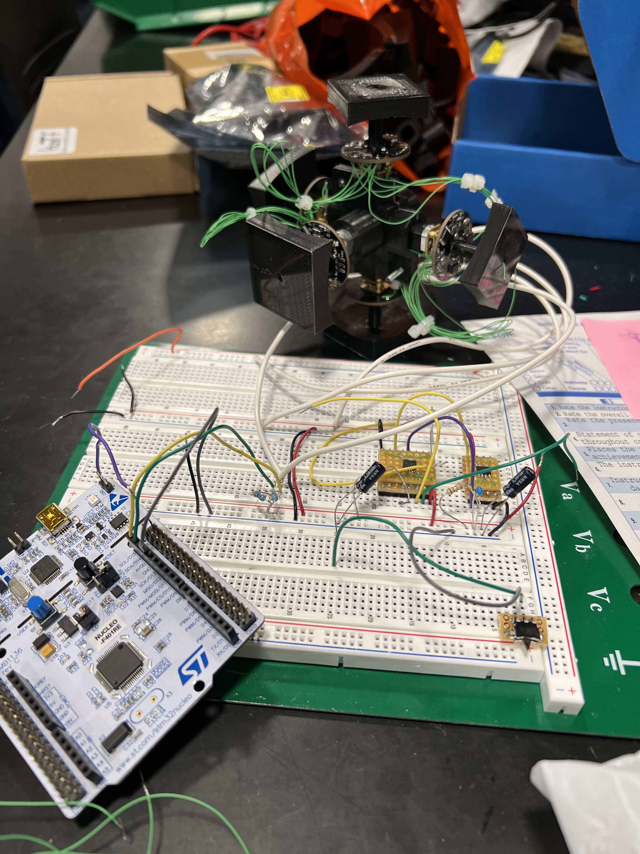
Prototyping Stage
Before designing your PCB, test your idea with discrete components and development boards.
Validate the functionality of your design before designing your PCB.
If your first PCB does not work, trouble shoot it (add, remove wires on your PCB) before refabricating.
Senior design projects, Fall 2022

Slide 4
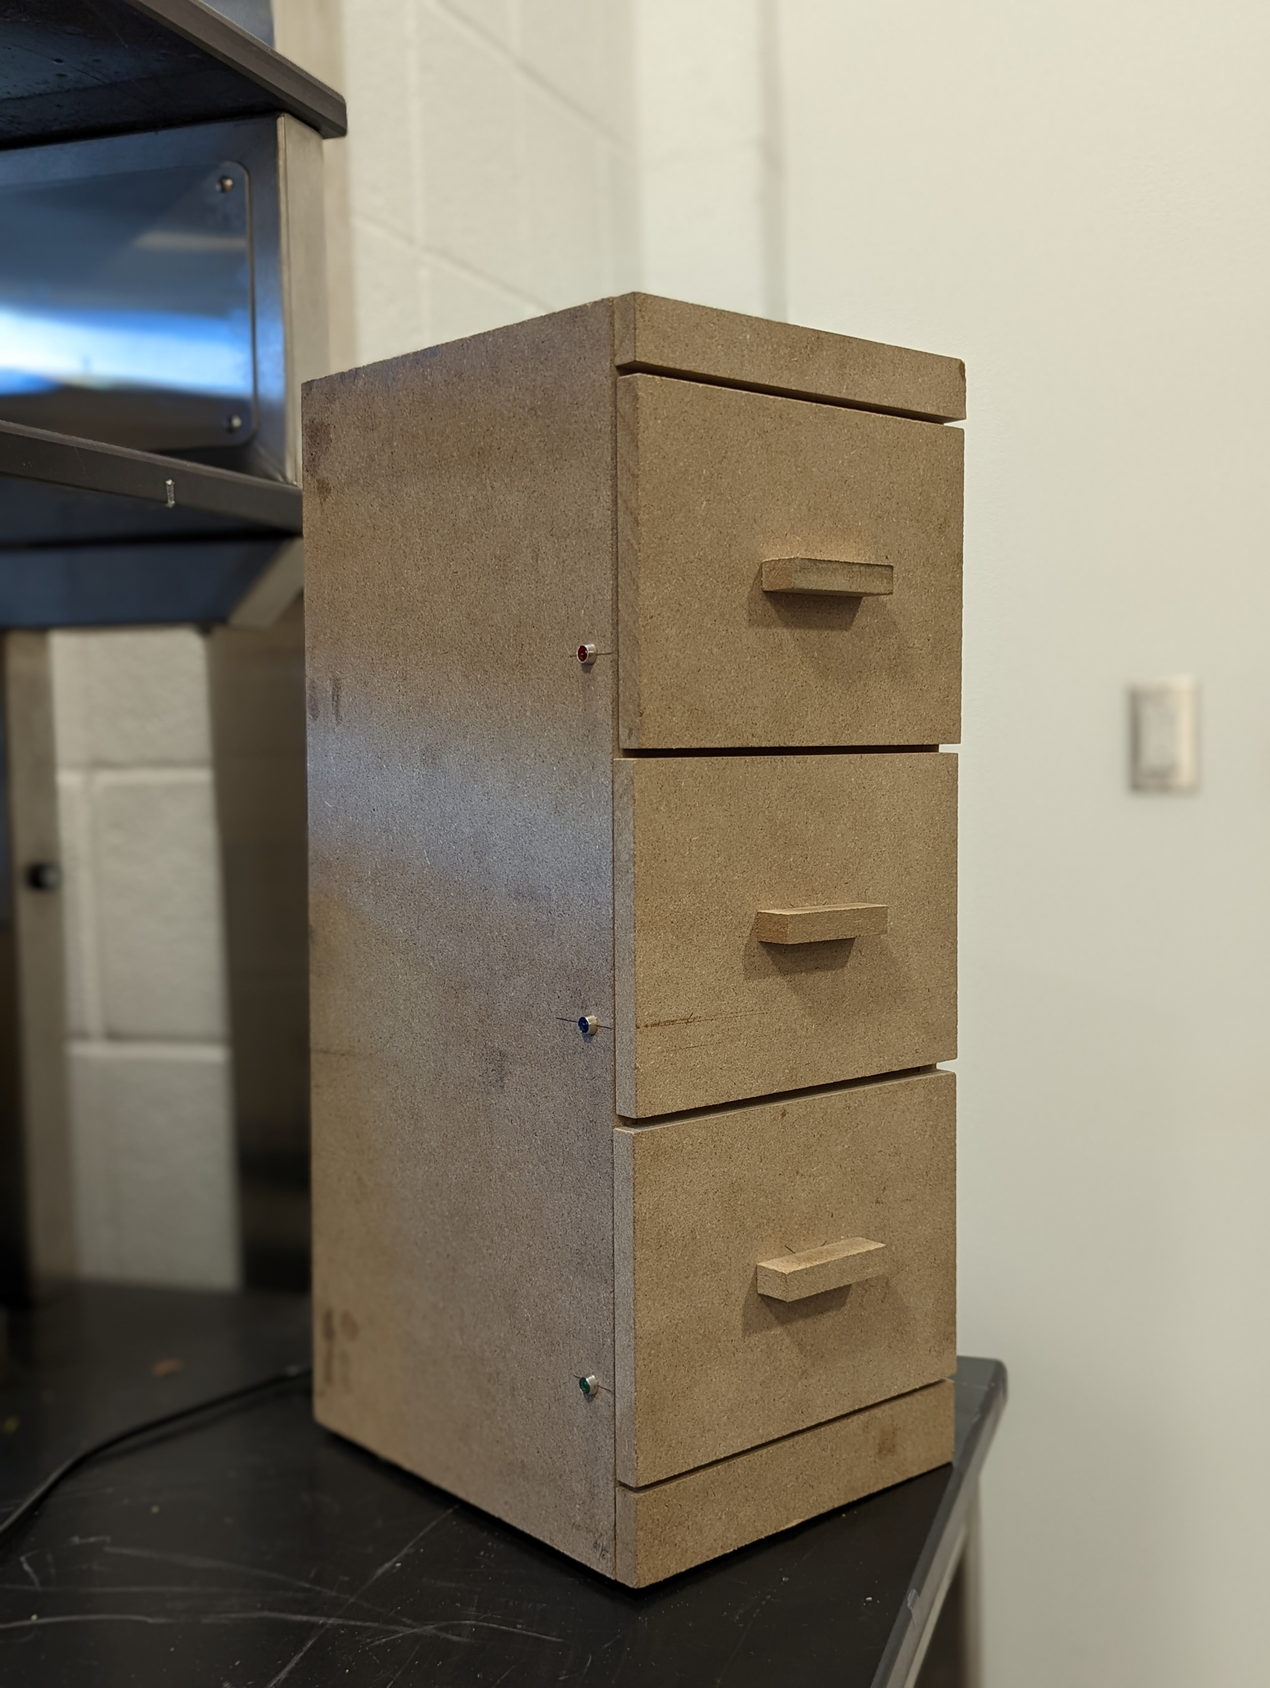
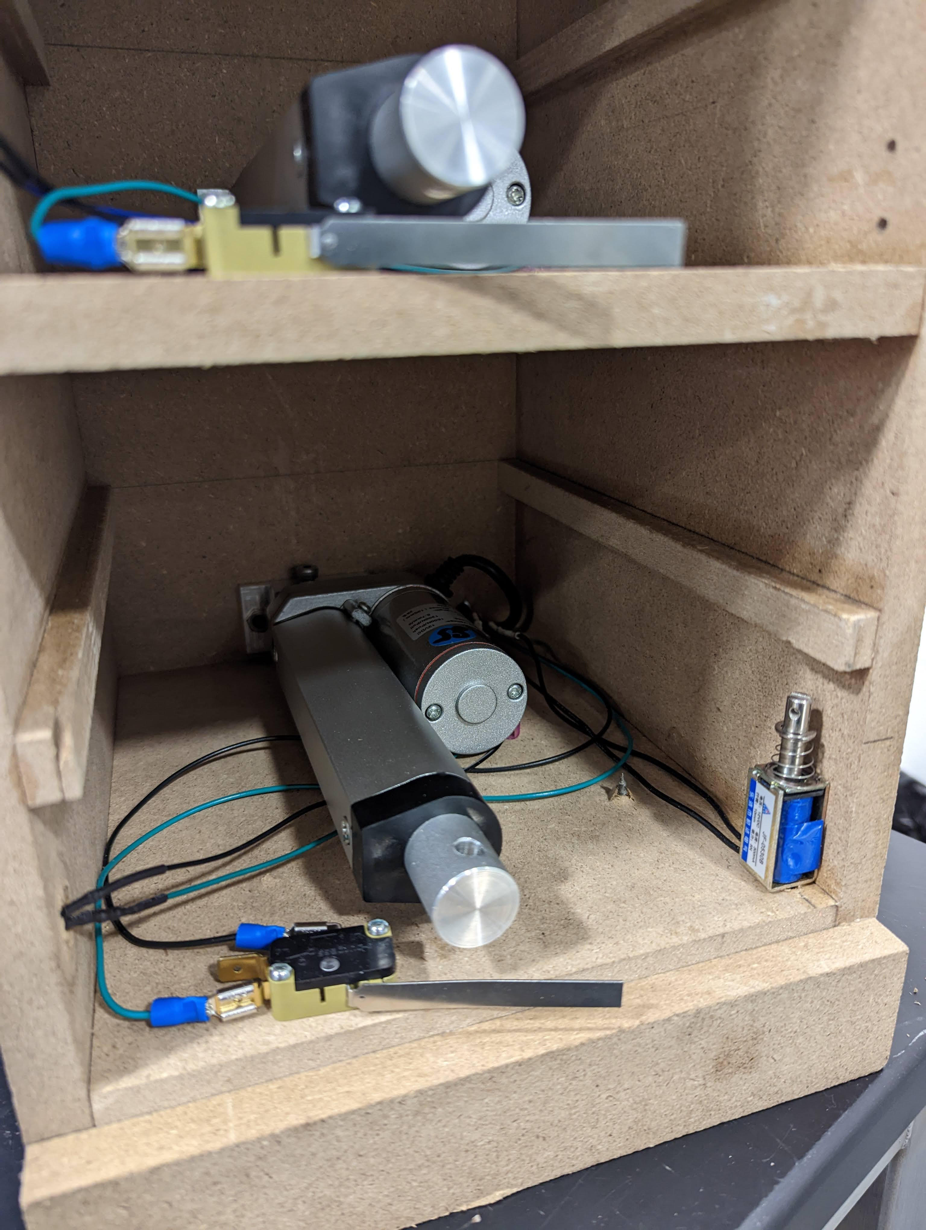
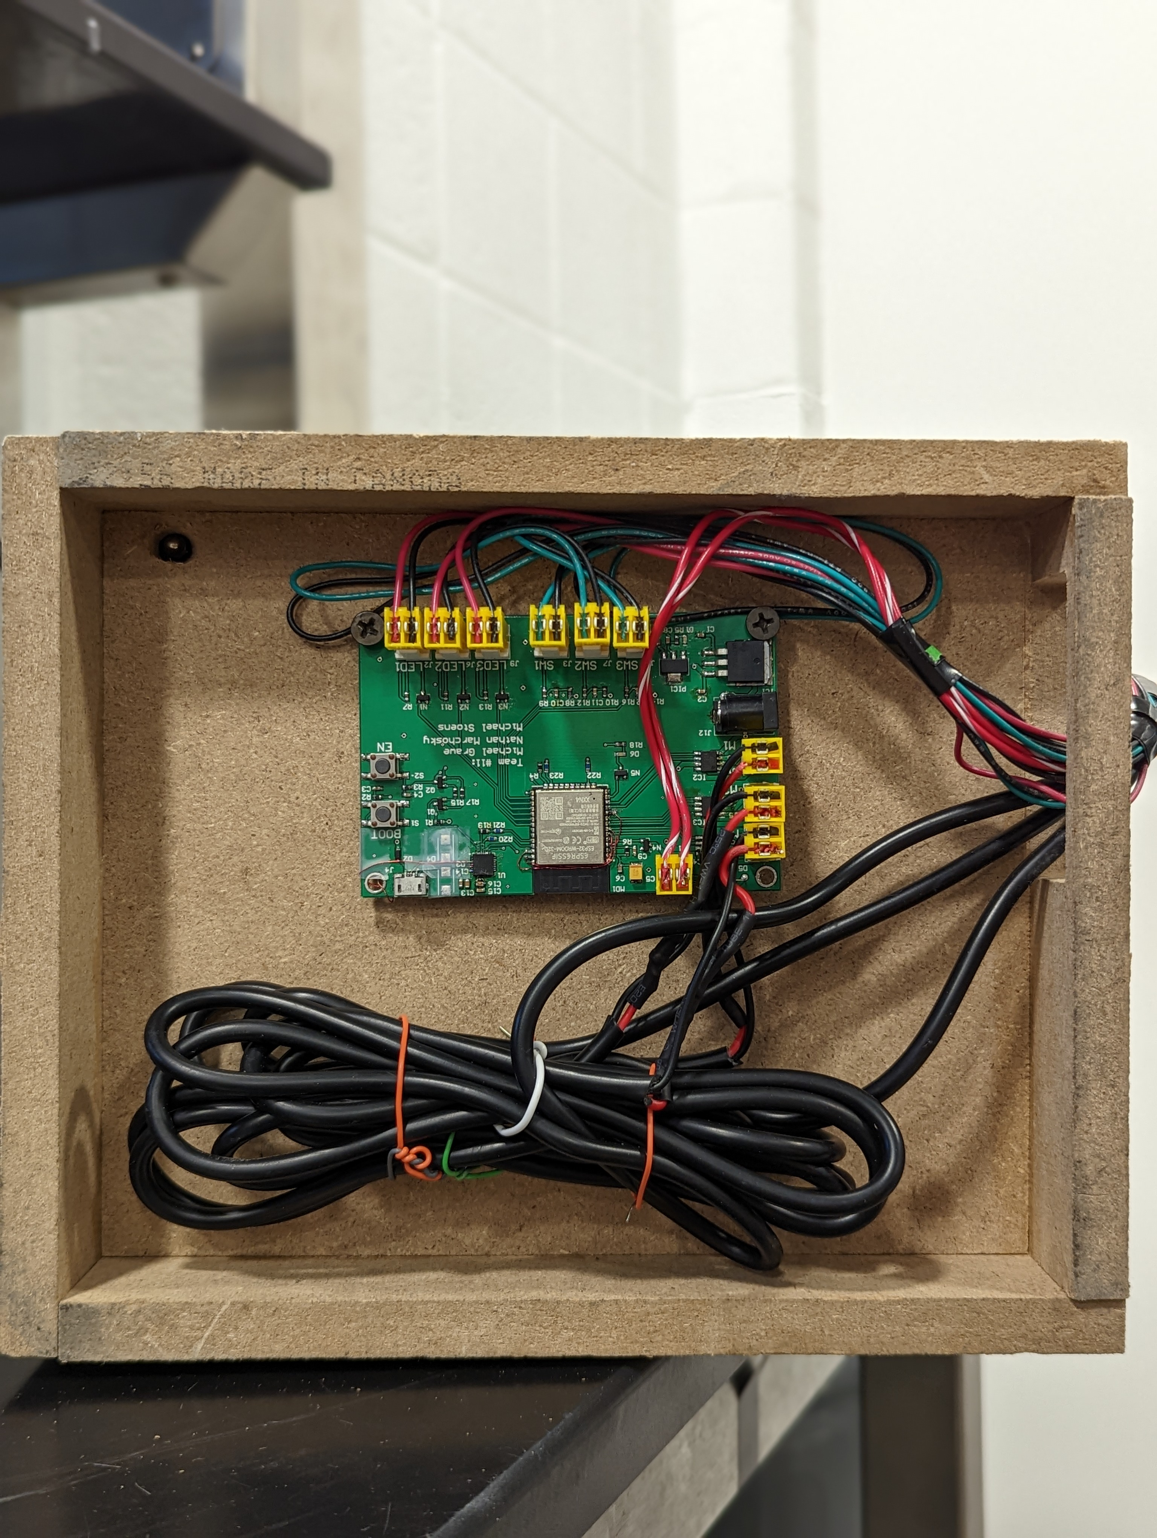
Designing your project with a custom PCB
Motors and Sensors in each drawer
Final Project Demo
Custom PCB
Senior design project #11, Fall 2022

Slide 5
PCB Design
PCB board has the following parts:
Microcontroller
Microcontroller programmer (don’t forget it)
Power regulator circuits
Sensor (on a separate PCB)
Motor controller (h-bridge)
Buttons and LEDs
Pay attention to the size of the components (print your PCB on a paper)
Pay attention on the types of surface mounts pads
Senior design project #11, Fall 2022

Slide 6
PCB Design: Do’s and Don’ts
Very small resistors are very difficult to solder. Avoid them
Voltage regulator – large size which will be easy to solder
Creative debugging. You can remove (cut) and add wires on your PCB
Large connectors and wide wires are necessary for large current drives
Do not forget the programming circuit for your microcontroller
Microcontroller. Pins are on the side and about 1mm in size which will be easier to solder.
Senior design project #11, Fall 2022

Slide 7
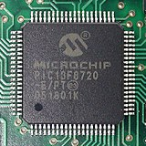
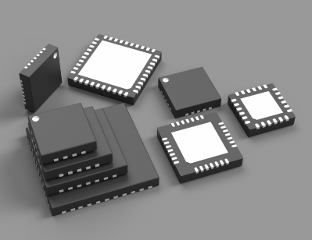
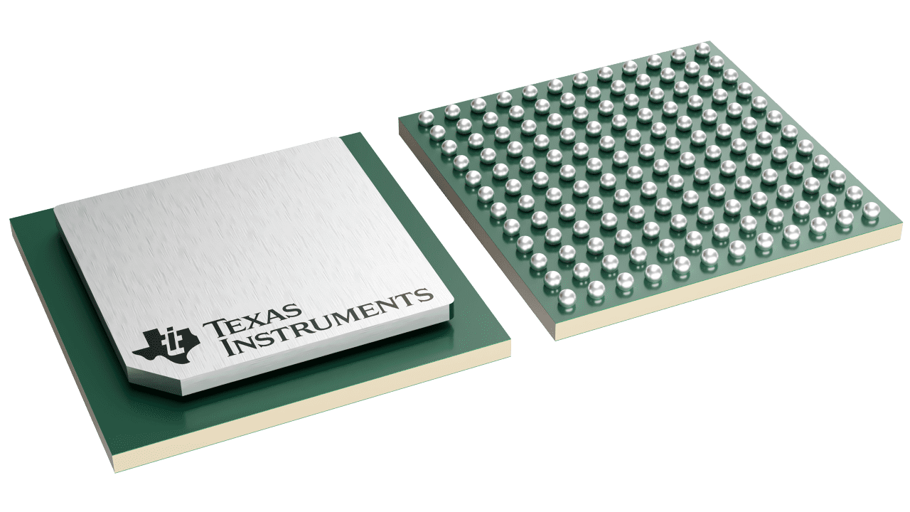
PCB Design: Common IC Packages
Quad Flat Package (QFP)
Quad Flat No-lead (QFN)
Ball Grid Arary (BGA)
wikipedia.com
pcbway.com
ti.com
Easy to solder
Joints are inspectable
Easy to fix bridging with flux and wick
Stencil required for soldering
Joints are difficult or impossible to inspect
Hard to fix mistakes
Thin, electropolished stencil required for soldering
Impossible to inspect joints

Slide 8
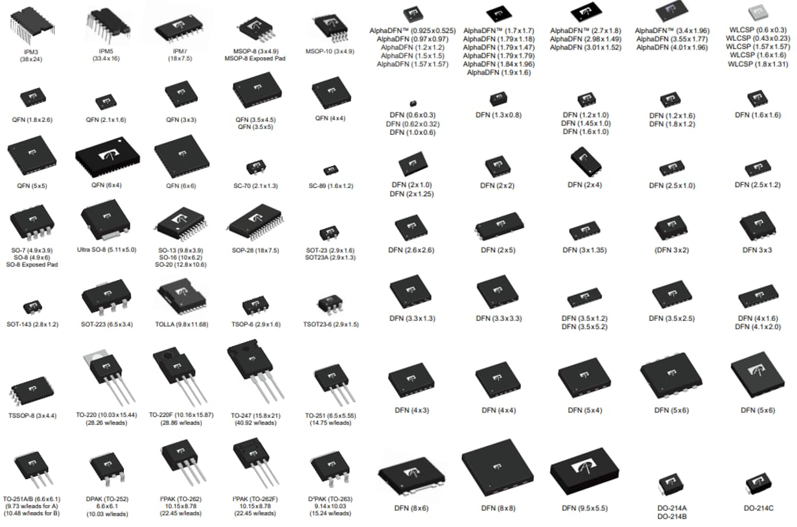
PCB Design: Other IC Packages
There are many kinds of IC packages available
When you import a footprint into KiCAD, compare it to a part you know the size of (like your microcontroller)
Print out your PCB design to get a sense of component size

Slide 9
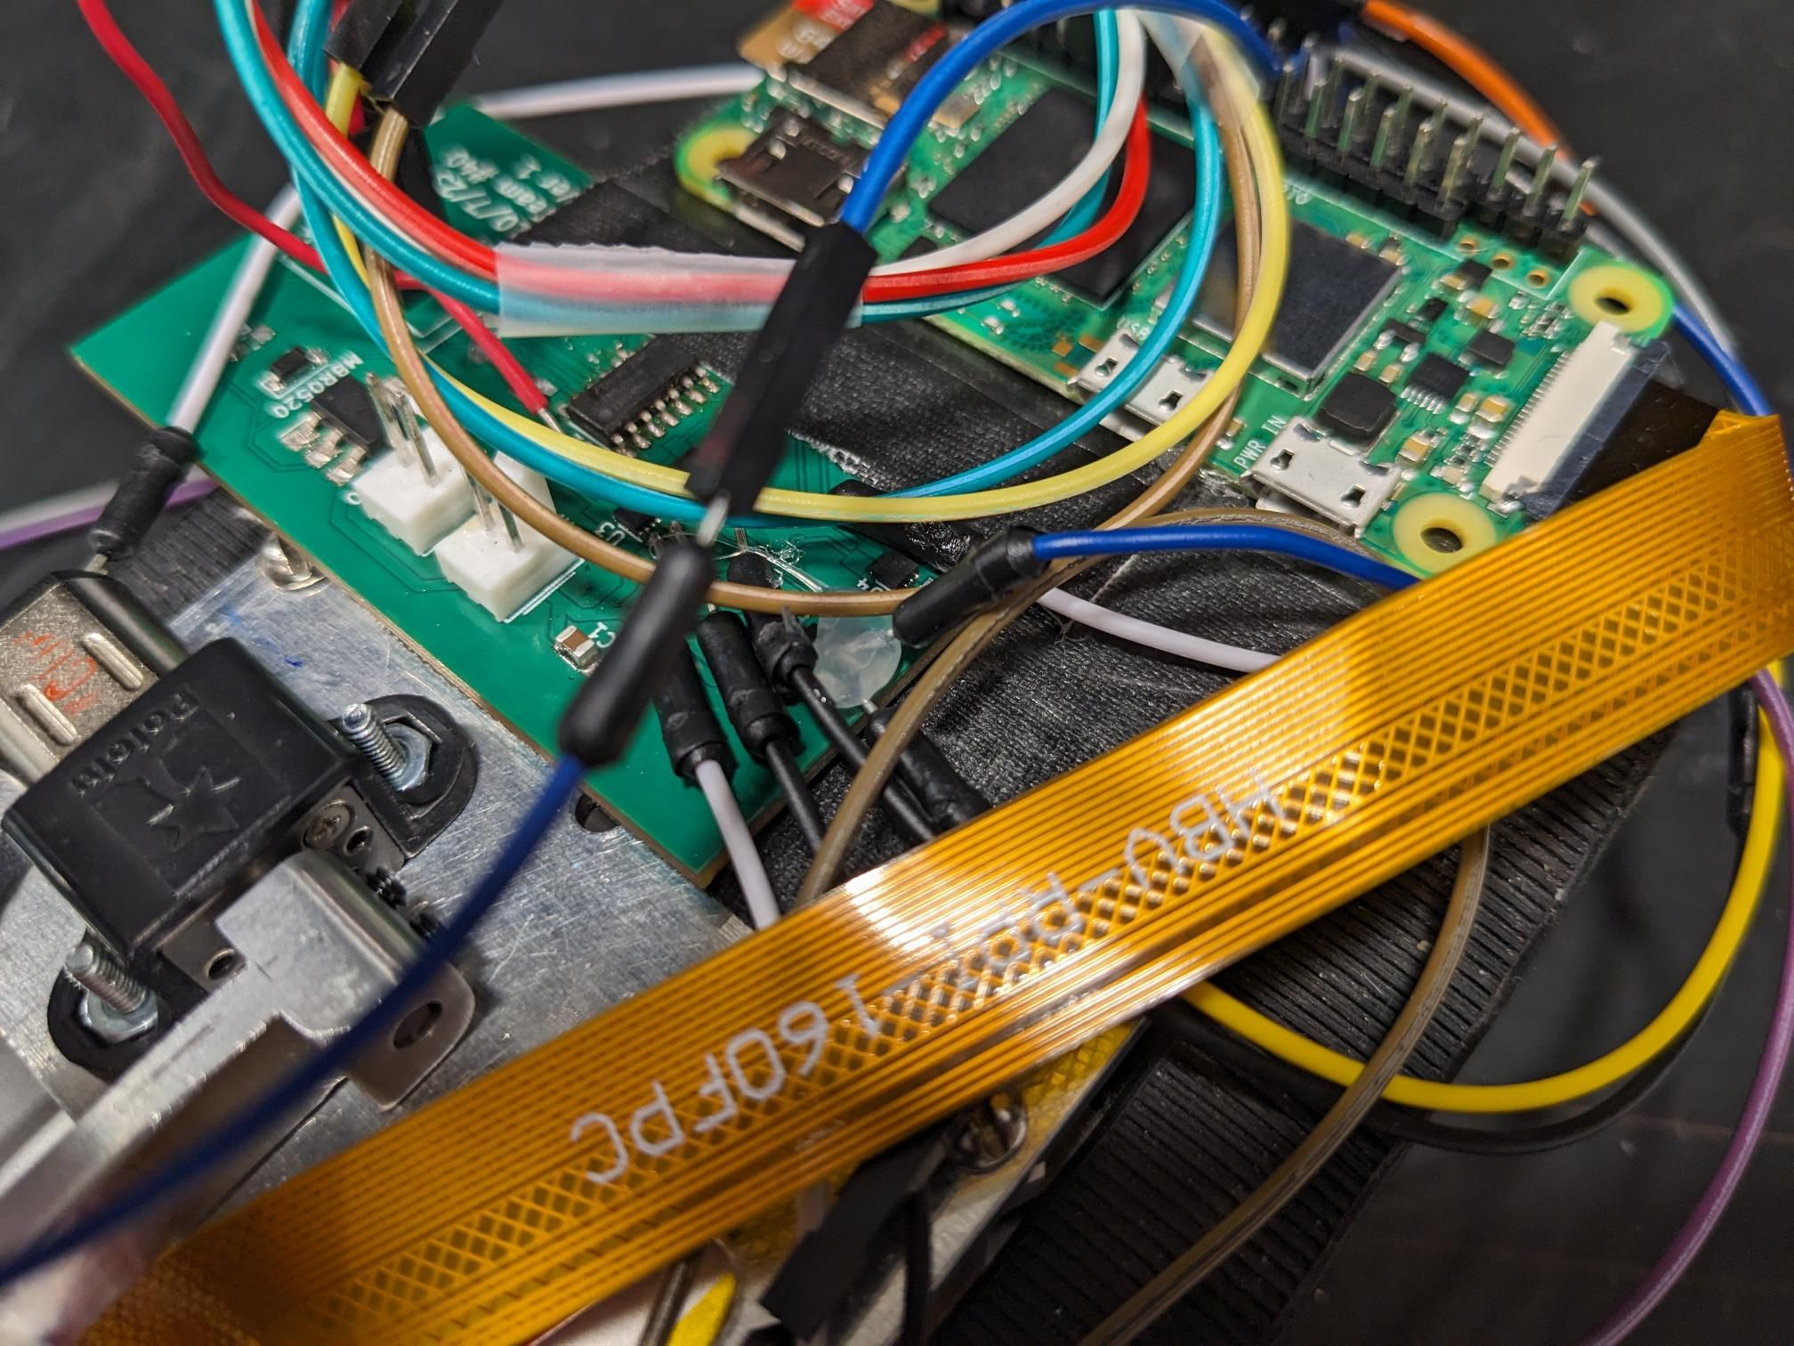
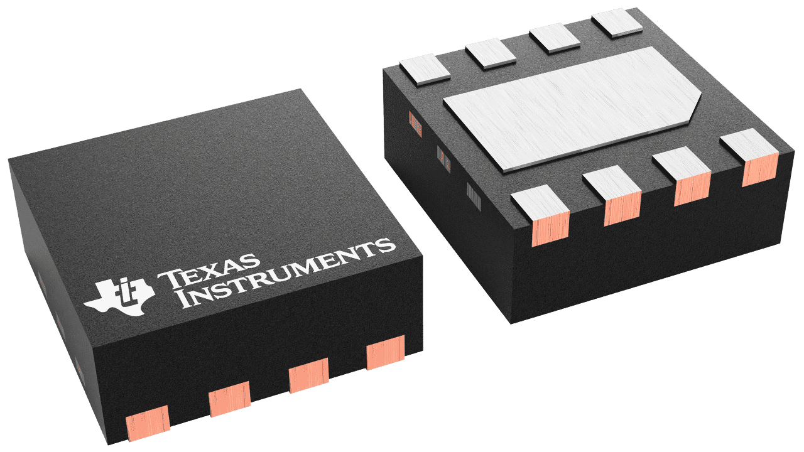
PCB Design: Poor IC Package Choice
Example: DRV8837 H-Bridge
Plastic Outline No-lead Package (WSON)
Part is 2.1 mm x 2.1 mm!
Lead pitch is 0.5 mm!
Leads under package made debugging very difficult

Slide 10
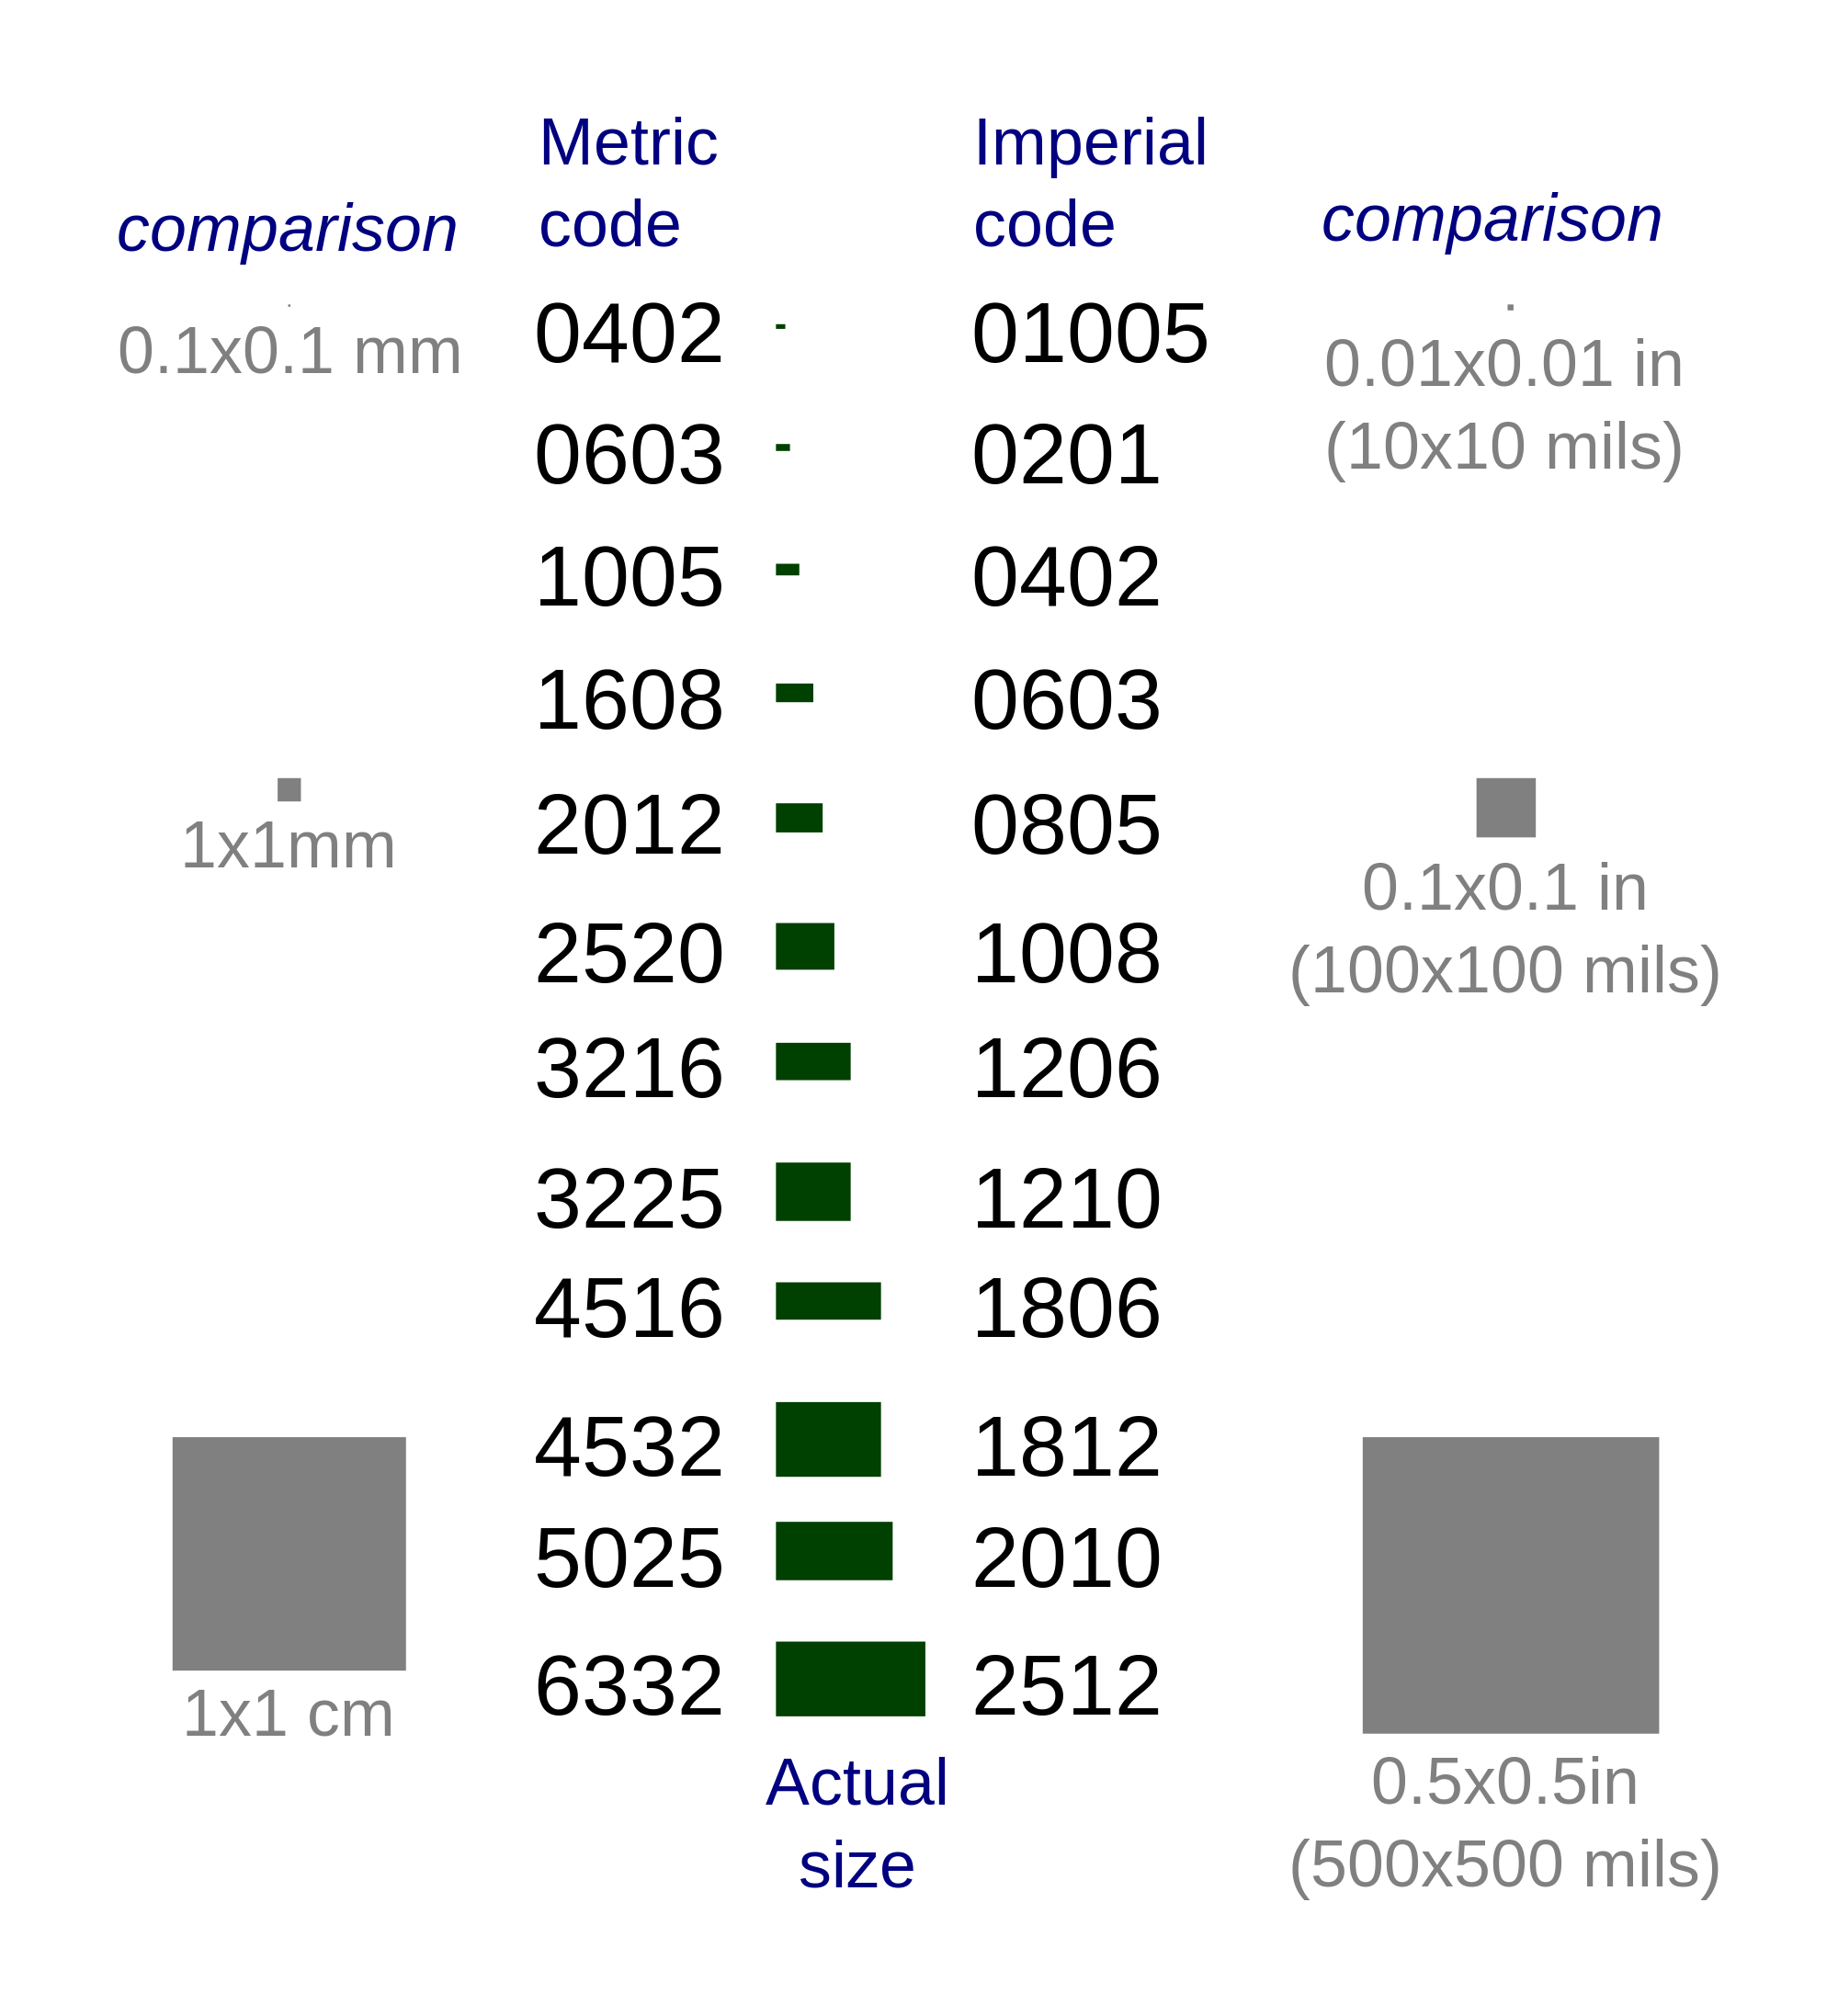
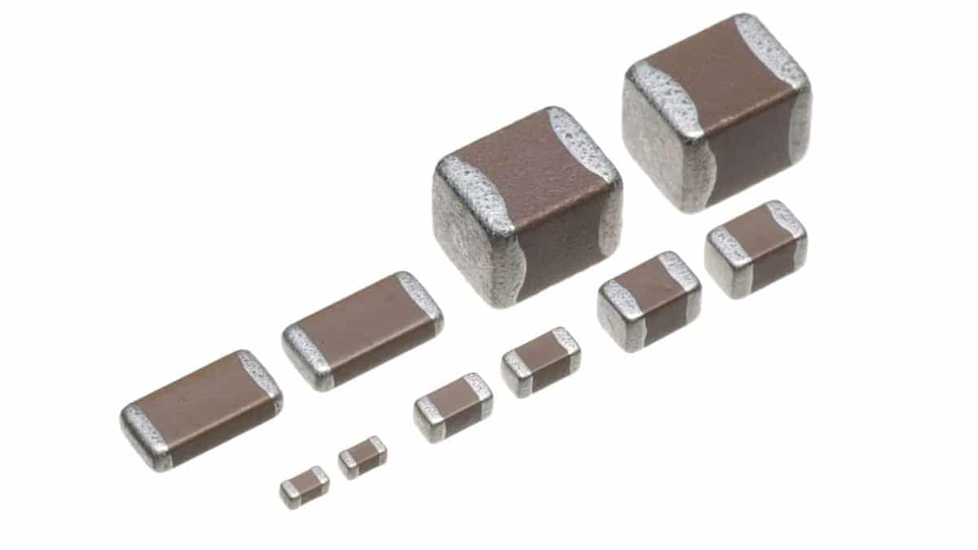
PCB Design: Passive Component Packages
Passive components like resistors, low value capacitors, and low value inductors are packages as small rectangular prisms with metal ends
0805 Imperial is usually a good size
You can use larger sizes for shunt resistors and bulk capacitance
Don’t try to use anything smaller than 0603 Imperial
Remember to order extra!
Can you guess what the problem with this is?
https://passive-components.eu
https://weatherhelge.wordpress.com/smd/

Slide 11
Any questions so far?

Slide 12
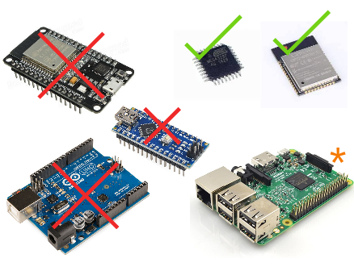
Processor Policy
Microcontroller ICs and modules are permitted
Development boards are not allowed*
Single board computers (e.g. Raspberry Pi, Nvidia Jetson, etc.) are allowed under certain circumstances

Slide 13
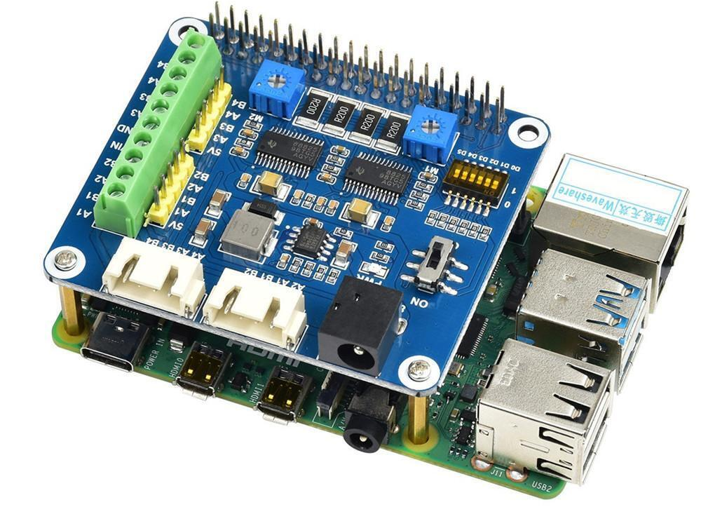
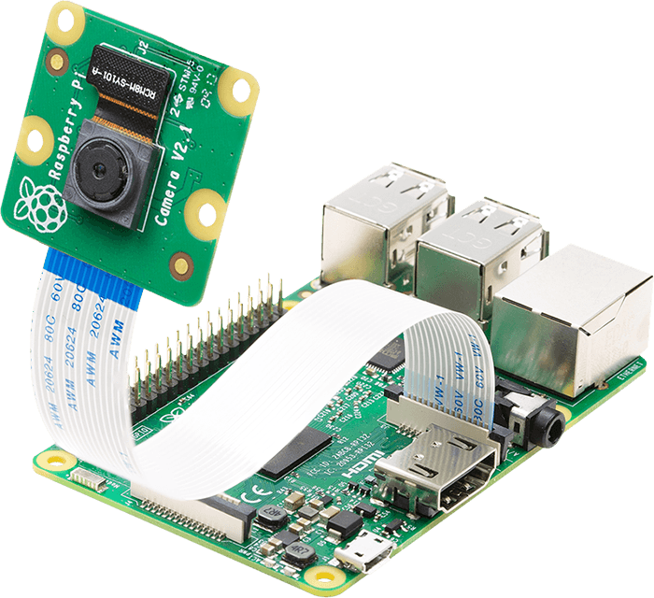
Processor Policy: Single-board Computers
A PCB acting as a “Pi Hat”
This is a good way of interfacing a custom PCB with a Raspberry Pi
arducam.com
You may use a Raspberry Pi as a secondary processing unit
Operating a camera and handling image processing loads is a popular task for single-board computers
Your custom PCB must still contain a microcontroller along with the rest of your circuit

Slide 14
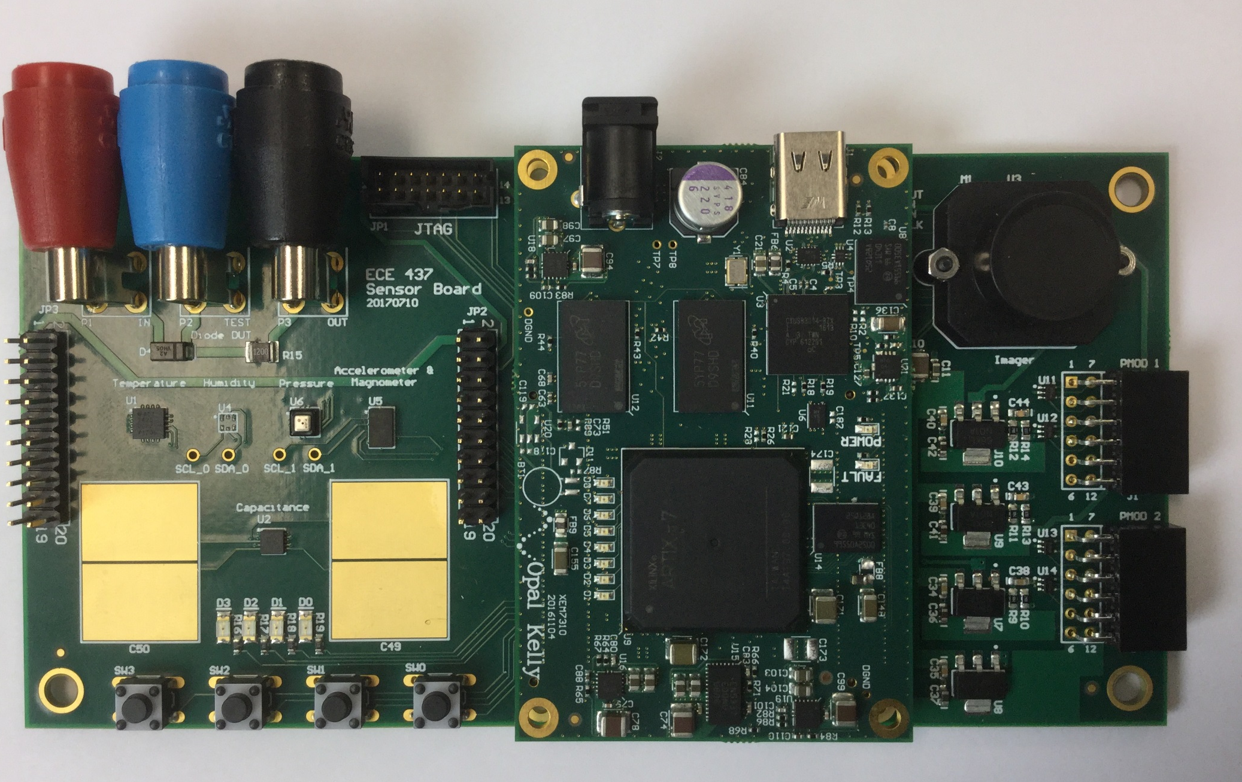
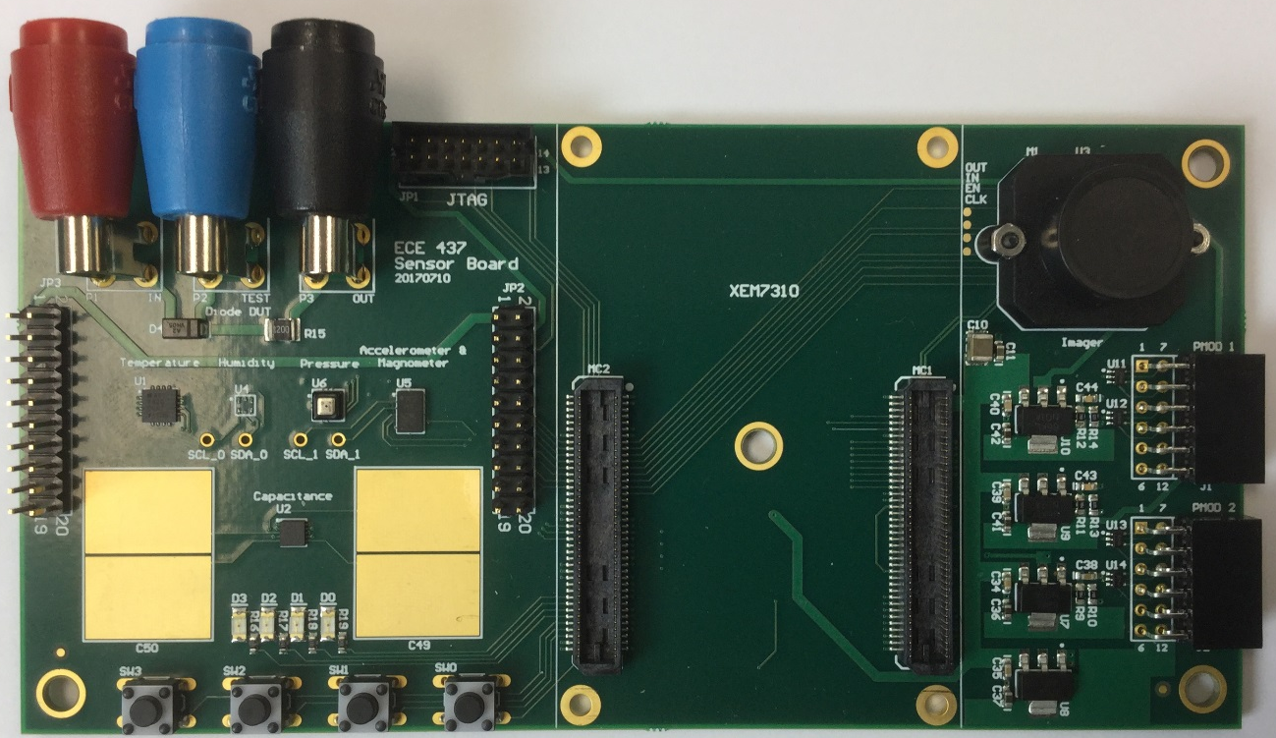
Processor Policy: Development Board
ECE437 sensors board
camera
FPGA board
from OpalKelly
sensors
Connectors
to FPGA
Main PCB contains many components (sensors, camera, LEDs, buttons).
Main PCB should also contain a microcontroller
Main PCB has to interface with your development board
In this example, FPGA dev board from OpalKelly is interface with a custom PCB.
The development can be used for image processing or more complex signal processing (for example, machine learning algorithms on FPGA such as mobile net.)

Slide 15
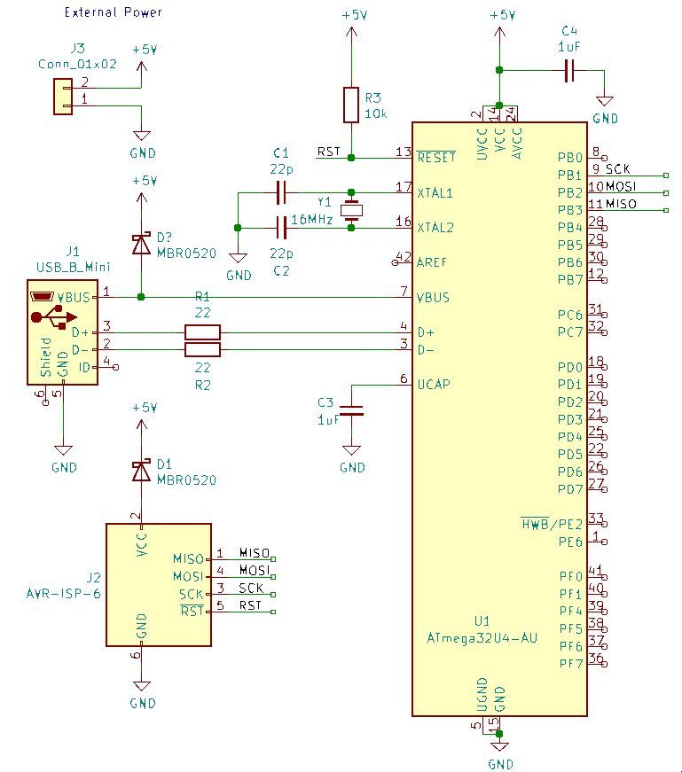
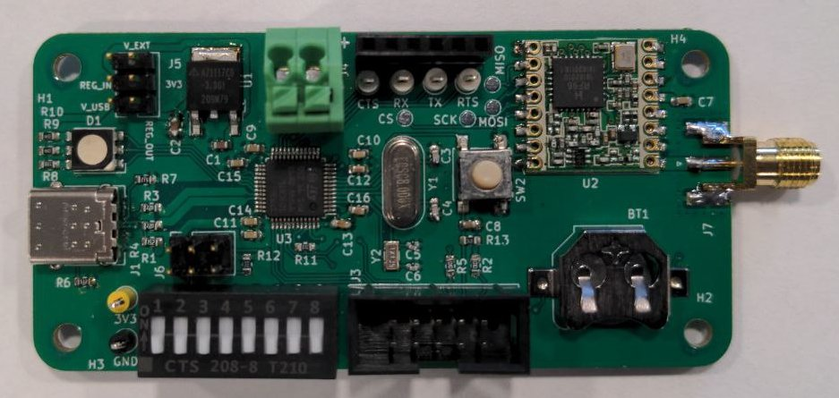
Design Resources
STM32
ATMega
ESP32
The ECE 445 wiki has example projects available for microcontrollers kept in stock by the electronics service shop

Slide 16
The wiki contains information on:
Regulator selection
Connectors
Importing parts into KiCAD
Microcontroller programming

Slide 17
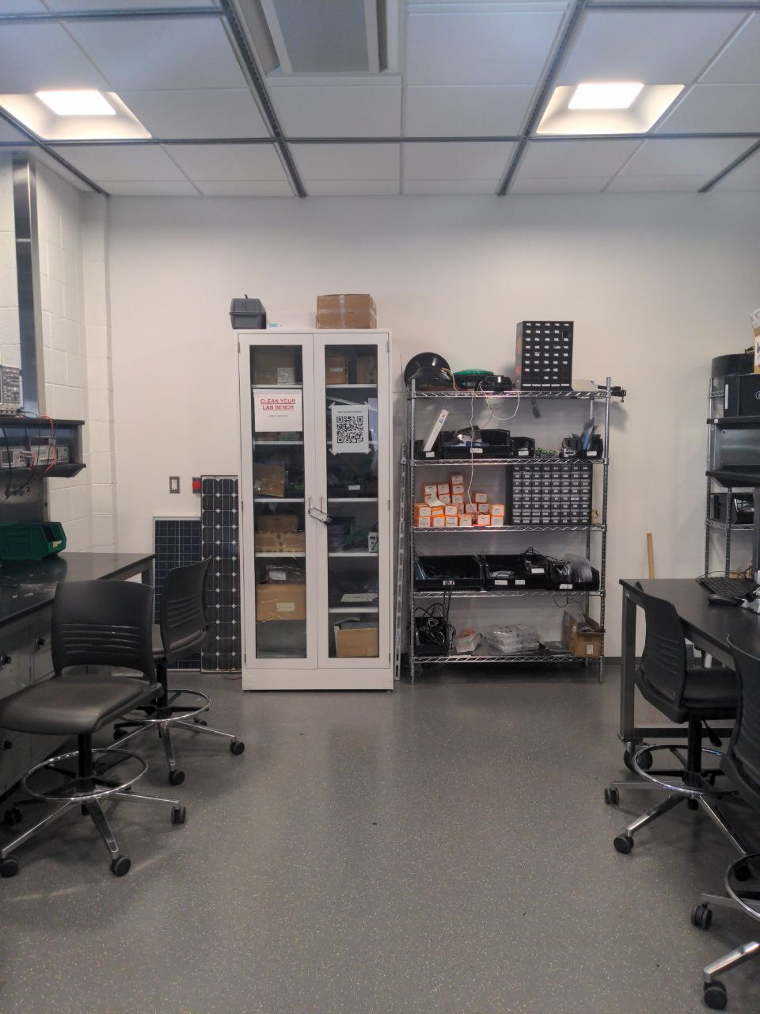
Getting Parts: Senior Design Lab
You may borrow development boards, programmers, autotransformers, sensors, etc. from the white cabinets
These items should be returned at the end of the semester
Any TA can check out parts to a student

Slide 18
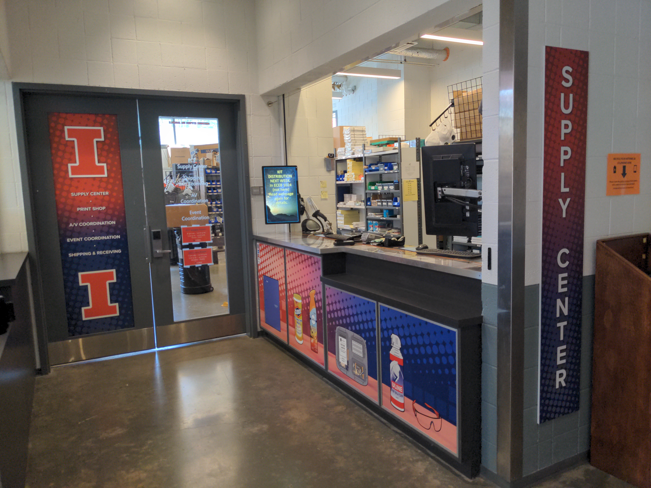
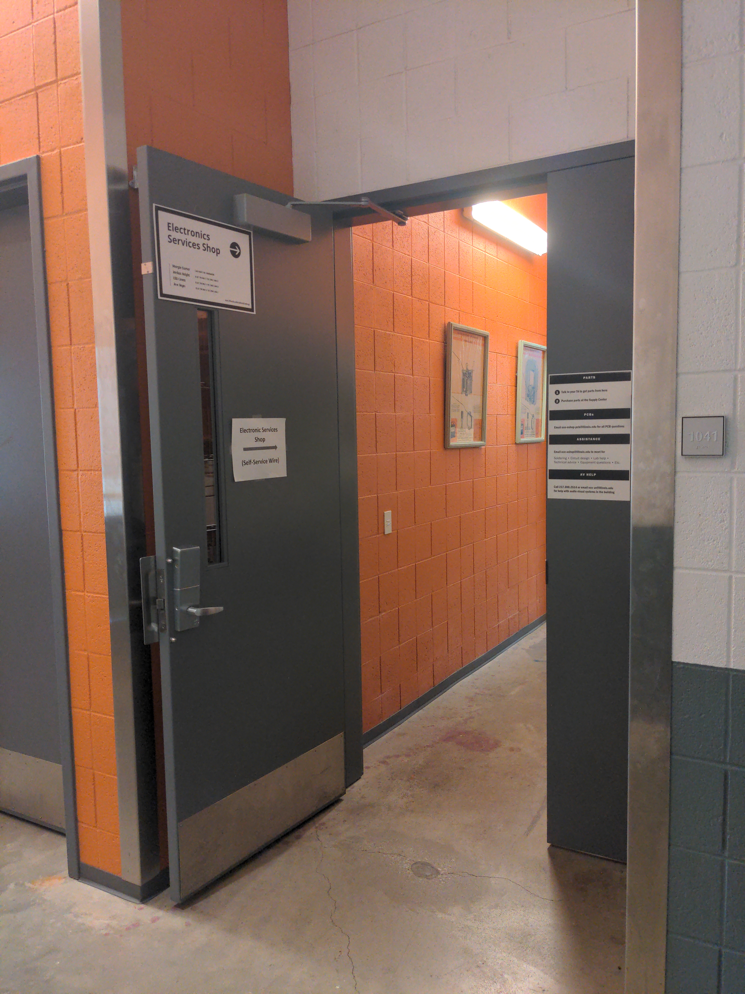
Getting Parts: Supply Center and E-Shop
ECE Supply Center
Near the loading dock
Stocks through-hole components, project boxes, sensors, etc.
Not free
Electronic Services Shop
Near the north exit to Wright Street
Stocks connectors, potentiometers, through-hole components, etc.
Also stocks surface-mount components deliverable by your TA
Surface mount components include microcontrollers, passive components, and oscillators

Slide 19
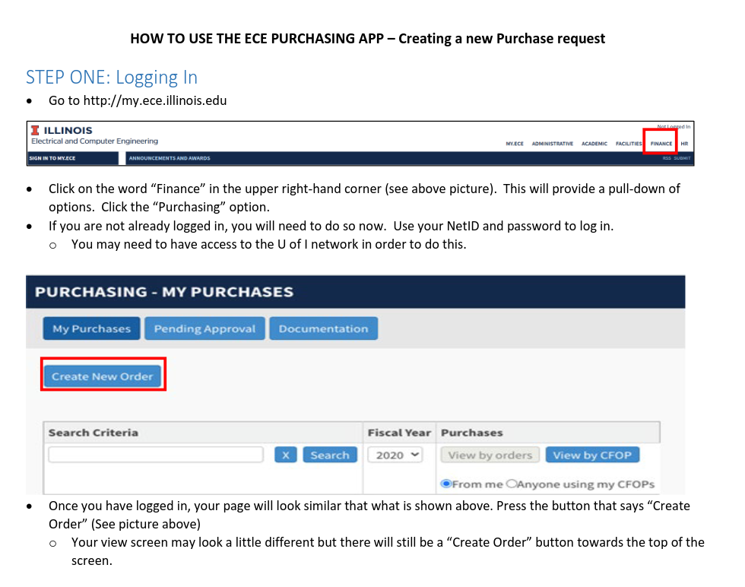
Getting Parts: my.ECE Ordering
You may use your budget of $50 per student to order parts from Digikey, Mouser, etc. through the business office
A CFOP number for this course will be shared shortly
Note that Digikey is short staffed at the moment so they are slow to send out orders
During the middle of the semester, orders may take many days to be placed

Slide 20
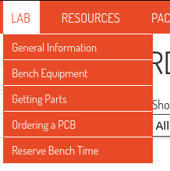

Slide 21
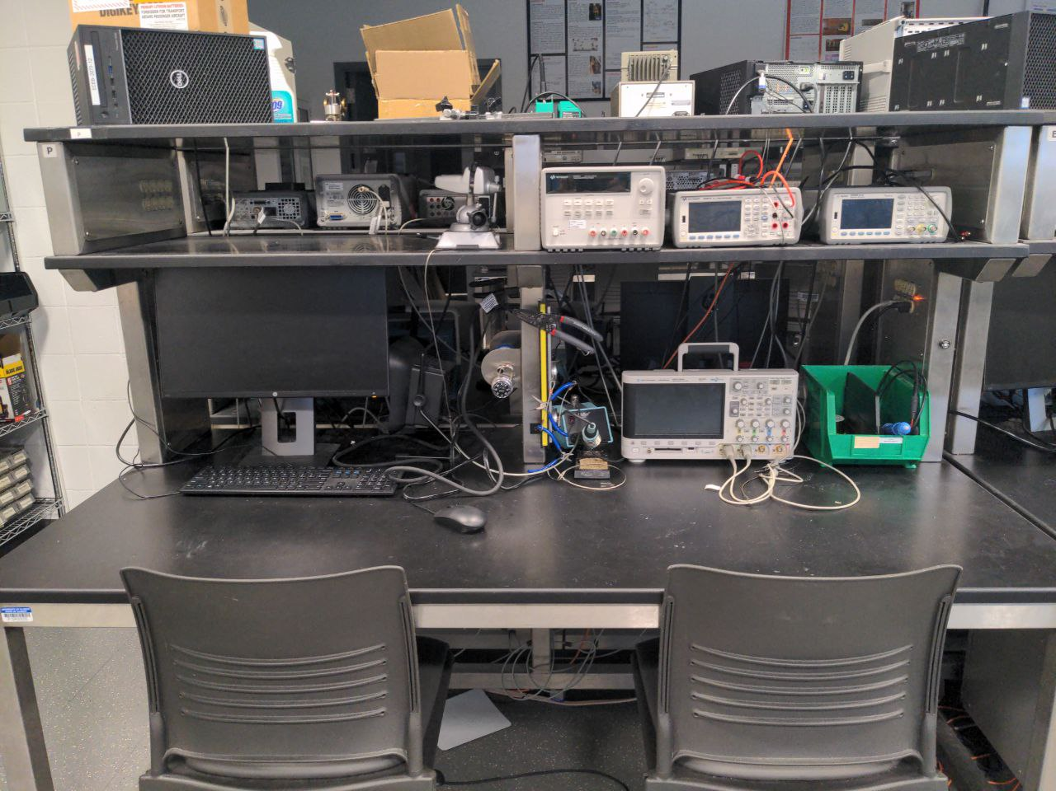
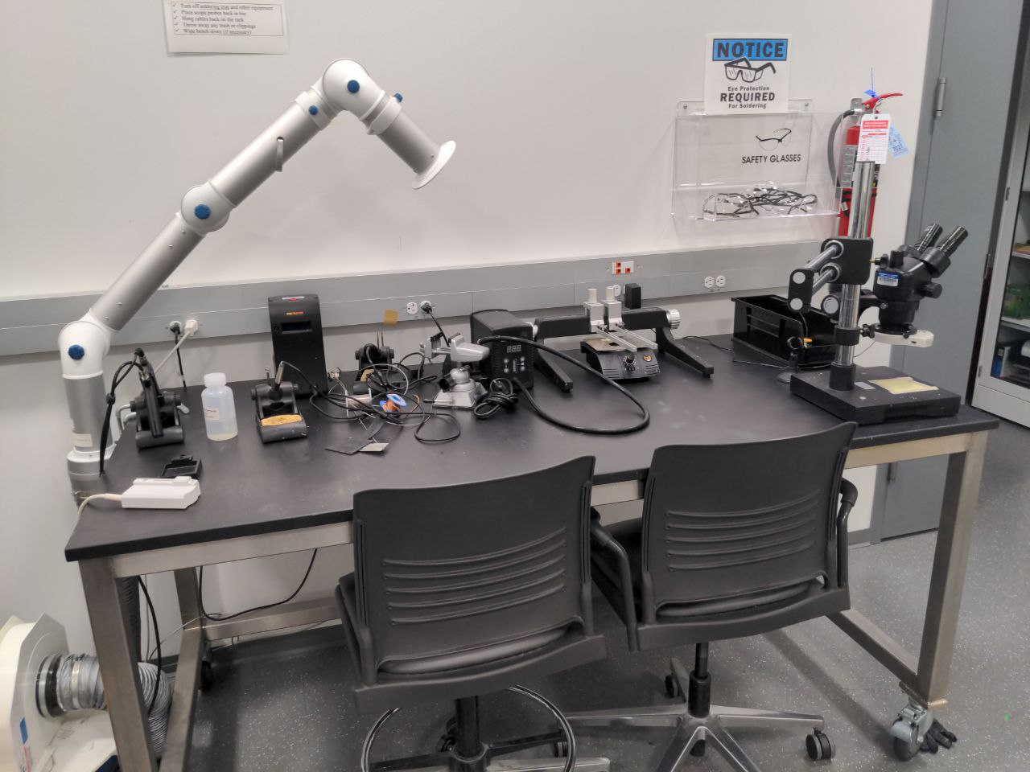
Clean Your Lab Bench! (Radar Enforced)
Please keep the lab benches and the soldering stations clean
When you finish working:
Remove any bits of solder, wick, or wire clippings on the table
Turn off equipment (e.g. soldering irons, extraction fans)
Untangle cables that tie tools down
Wind up unspooled solder and wick
We will have to shut down the lab if it gets too messy

Slide 22
Any questions?

